Slide 1
Texas Community Development Block Grant Program
Monitoring
Administrator Workshop

Slide 2
Role of Compliance Monitor
Conduct Comprehensive Monitoring
Grant Recipient’s Performance
Review Project Records
Detect and identify possible fraud and abuse
Notes:
Before we get into the nitty gritty of the fast-paced deep dark process our internal sleuths, also known as monitors, I want to collect some information from the room that will come into play later. For those of us who spent our childhoods anywhere between the 60’s and 90’s, you might figure out where this is going. You’ll have to be patient for the outcome. The same level of patience you may or may not need to wait for our monitoring reports. I’m going to collect a series of words and phrases from y’all:
Verb, past-tense, negative connotation
Noun for a type of asset
Verb ending in –ing
A type of unexpected event
An action or process – generally positive
Job title
Type of fine or ticket
Type of penalty or punishment
The Texas Community Development Block Grant Program is responsible for ensuring that CDBG funded activities are completed, and funds are expended in accordance with the provisions of the agreement and applicable regulations, policies, and related statutes. In order to fulfill this responsibility, TDA has established the agreement compliance process.
The Monitor will conduct a comprehensive compliance review of the Grant Recipient’s records to ensure that these requirements are met including:
GR Performance- review the activities completed and ensure that the bene’s identified in PS are being served.
Review records including procurement of all vendors/service providers, review executed contracts, ensure compliance with labor laws/regulations, review civil rights, review all financial records and any other project related activity regardless of funding. Ensure that the city/county has sufficient policies and procedures to ensure adequate controls in place to protection against fraud and misuse of funds. If potential fraud is identified, of course, we would escalate to the proper authorities- likely to HUD’s Office of Inspector General.
Our process seeks to answer many questions such as: Does the city/county have adequate controls in place to ensure – grant or community- funds are not misappropriated. Does there appear to be any conflict of interest? appropriate use of funds? Conduct a comprehensive review of funds identified in the budget and related costs have been expended accordingly.

Slide 3
Role of Compliance Monitor
Technical Assistance
Training opportunities
Avoid potential issues in future
Identify Corrective Action
Require appropriate action
Notes:
Provide technical assistance
Training Opportunities - TDA staff , consultants or grant recipients
Reveal a need for additional technical assistance or further guidance so that a community does not have a finding or ineligible costs in the future
If failure to comply with local law, regulations, or program policy is identified, the city/county will be issued a “Finding” which requires submission of a CAP- more on that later….
Note: corrective action might be to submit additional records that verify compliance.
Compliance staff provide: program oversight - internal and external

Slide 4
Review Types
TxCDBG project will fall into one of these categories:
Self-Monitoring Review
Desk Review
On-Site Review
All projects require comprehensive review of financial management records.
Notes:
A Monitoring Review will generally be conducted when at least seventy-five percent of the CDBG funds are drawn, and the construction or project activities are substantially completed or if the closeout process has begun in TDAGO
The three methods of monitoring reviews that TDA utilizes are self-monitoring, desk review, and on-site review.
In order to determine the method of review, TDA uses a risk assessment tool to objectively evaluate the programmatic compliance risk of CDBG-funded projects
Each type of review includes an examination of the Grant Recipient’s project records to assess compliance.
However, non-standard checklist or categories may also be included in a review if the project includes special types of projects, such as housing rehab.
Each type of monitoring review will require specific responses or documentation.
Regardless of the monitoring type, all projects require comprehensive review of financial management records. This includes both grant and local funds injected

Slide 5
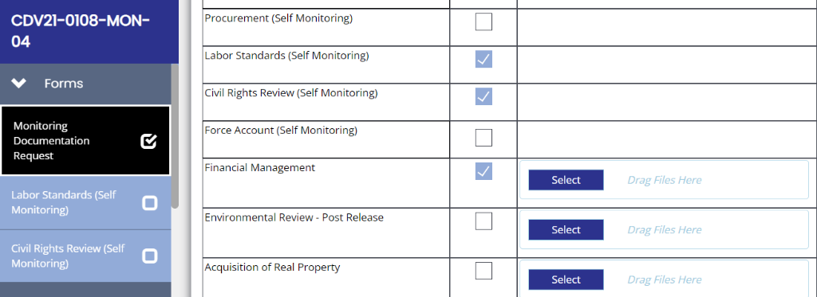
Self-Monitoring Review
Projects generally rated as “low-risk”
Complete all requested sections
Organized project related financials
10% may be selected for desk review
Notes:
A CDBG agreement rated as low risk generally qualifies for a Self-Monitoring review; however, at least 10% of low-risk agreements will be randomly selected for a desk review.
The Monitoring Review will be initiated by TDA staff in TDA-GO. The Compliance Monitor will select the areas for review and type/method of review, as indicated on the Monitoring Documentation Request form and an automated email notice will be delivered to certified administrators (Project Director and Consultant roles) assigned to the grant document at least two weeks prior to the date requested documents are due.
Please be sure to upload all financial management records and complete the appropriate self-monitoring checklists. All Financial Management Records must be submitted and include:
Copies of draw requests
Bank records verifying grant-related and match related transactions
Financial Interest Reports
Copy of the ledger used for tracking project fund receipts and disbursements
Most recent audit
Fidelity Bond, if any
Send a ledger with your financials. As well as a set of organized and legible documents!!!
Consider putting the deposit slip and copies of cleared checks behind each correlating payment request.
If part of invoices is both grant and match- indicate on invoice and ledger.
We must have a complete set of match or cost overruns prior to approving the closeouts.
HINT: If you have them, send them now instead of waiting for us to ask once the PCR is forwarded to compliance.

Slide 6
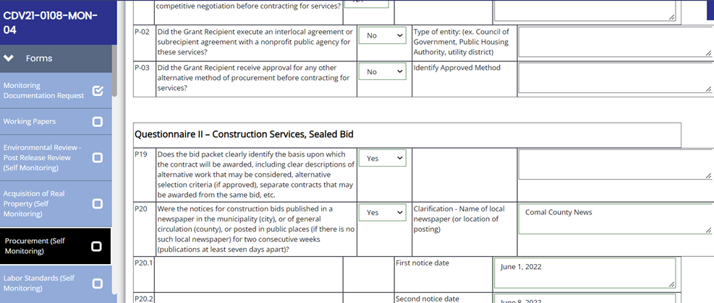
Monitoring Procedures
Complete each question
Include clarification when appropriate
If violations are identified, submit:
Relevant documentation
Grant Recipient written CAP
Evidence that finding can be remediated
Notes:
If the GR conducted multiple Procurement processes, repeat the steps for each service provider. The same process would be followed for Labor Standards self-review if your project involved multiple Prime construction contractors.
You must answer all questions for each selected activity. Include clarification or further explanation if needed in the comments box.
INCLUDE ADDITIONAL INFORMATION AS REQUESTED. MONITORING REVIEW WILL BE RETURN FOR INSUFFICIENT INFORMATION
If the GR failed to follow TDA procedures or violated a federal law or regulation, the GR should self-report the violation and include an executed Corrective Action Plan. – more on CAP later in presentation
When the applicable steps are completed, the checklist must be certified by the Authorized Official and CDBG certified administrator. The AO must change the status to “submit” the Monitoring Form.
Again, all reviews regardless of the “method” requires submission of the financial records as specified in Chapter 13 of the CDBG Implementation Manual.

Slide 7
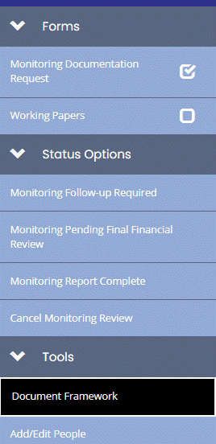
Monitoring Procedures
Common Errors
Identify all vendor contracts
Ensure Labor section is complete
Details are important!
Corrective Action is follow-up
Document messages
Monitoring Finding Report
Submit revisions - CAP
Notes:
For procurement, please be sure to repeat steps for all vendor contracts and check the appropriate method of procurement.
click the form and type the vendor’s name and select the appropriate “type of procurement” (such as in this example- construction sealed bids) . The system will auto populate the forms to the completed.
the same process would be followed for Labor Standards self-review if your project involved multiple Prime construction contractors.
Some of the issues I've noticed this 1st year is:
Labor page: if the LSO requested additional wage classifications and rates don’t answer Yes without including the “classifications and rates” in the clarification box.
If there was an addendum issued or change in BO date, include explanation, dates, date of additional publication notices, etc.
add type of fair housing activity. If city council Proclaimed FH month – how was the public notified? where and when did the GR post or publish the public notice?
be sure that MSR’s are correctly identified. Ive seen several lately that indicted a competitive bid for construction contractors – they should have been marked “sealed bids”
Please READ question before indicating yes, no or NA another words, “NO” is not always the wrong answer.For instance:
ERR question is: “Did the Grant Recipient commit HUD funds or non-HUD funds or undertake a choice-limiting action prior to the State’s environmental clearance?” The answer is hopefully NO not YES, as that would be a very serious violation
TDA staff cannot changed or correct any responses on these checklists – so please be careful so the forms don’t have to be returned for revisions.
When the applicable steps are completed, the Authorized Official must change the status of the Monitoring Form.
IF A FOLLOW-UP IS REQUESTED, ONCE REVISIONS AND ADDL DOCUMENTATION SUCH AS CAP OR RECORDS ARE UPLOADED, THE AO MUST “SUBMIT” THE DOCUMENTATION TO TDA
No longer will compliance staff send separate emails or notices that a review was initiated in TDAGO. I highly encourage GR and Consultants to periodically check TDADO task for notices or follow-up requests.

Slide 8
Desk Monitoring Review
Projects generally rated as “medium-risk”
Interim Reviews
Randomly selected low-risk agreements
Separate and independent review of all records
Records must be organized
TDA reserves the right to conduct a desk
review
Notes:
A CDBG agreement rated as medium risk will receive a desk monitoring review. Typically conducted because it qualified:
medium risk according to the risk-based tool.
Or it may have been low risk but was selected as part of the 10% random tool.
Again, on occasions we may conduct an Interim reviews, due to the GR request, a Complaint received or Program staff request.
When scheduling a desk-review, TDA will notify the Grant Recipient at least two weeks prior as to what documentation will be required.
We realize that some of the documents such as civil rights may have already been sent to TDA however, we are conducting a separate and independent review of the GR and internal (TDA) records to ensure compliance. Please be sure to upload a complete set of records.
Also keep in mind that a desk-review may be conducted if TDA determines that a. desk-review is appropriate due to an alleged policy violation reported or management discretion
If a desk review requested, please be sure to upload a complete set of organized records.
Please separate and label or outline sections between records to ensure that the uploaded files are complete and submitted in a well thought-out manner.
Once the TDA the compliance monitor has reviewed the records and determined compliance, he or she will follow-up with either a preliminary finding or follow-up or formal written report of the GR overall performance.

Slide 9
On-Site Monitoring Review
Projects specifically requiring on-site review
Projects generally rated as “high-risk”
A complaint or request is received
TDA monitor will:
Review local files
Meet with local official and appropriate staff
Tour project site(s)
Conduct exit conference
TDA reserves the right to conduct an on-site review
Notes:
A CDBG agreement rated as high risk will receive an on-site monitoring review. On-site-reviews are typically conducted once at least 50% of funds are drawn, a complaint is reported to TDA that merits on-site monitoring and/or if TDA determines that an on-site review is appropriate.
When scheduling an on-site review, TDA will notify the Grant Recipient at least two weeks prior to the purpose of the review and schedule an entrance conference with appropriate local officials and their representatives.
The compliance monitor will:
review all applicable local files,
interview GR’s staff, engineers, consultants and/or project beneficiaries, as appropriate
tour the project(s) site - local official or staff who are knowledgeable about the project activities may need to accompany the monitor to answer questions about the accomplishments or construction completion.
Conduct an exit conference to present the preliminary concerns or findings which may result with a formal written report.
We do our best to resolve any concerns or findings at the preliminary stage. It truly not our goal to write long finding or concern letters and will give the GR an opportunity to provide missing documents or provide clarification on concerns/finding identified during the review. Again, TDA maintains discretion to monitor as needed or requested by management.

Slide 10
Decision Categories
Monitoring Review conclusions:
In compliance
Substantially the same as Performance Statement
Concerns identified
Technical Assistance is needed
Findings revealed, require further action
Notes:
As a result of the review, the monitor may reach one or more conclusions:
The Grant Recipient’s performance was in compliance with the requirements of the CDBG program;
Project achievements were substantially the same as outlined in the agreement performance statement;
Concerns about the project’s performance must be brought to the attention of the Grant Recipient;
Technical assistance was provided and/or is necessary as guidance to avoid potential issues in the future and/or;
Findings are revealed that require corrective actions.
The Monitoring Report conclusion(s), whether positive or negative, are supportable and adequately documented to identify every finding and/or concern.
According to HUD, a finding is a violation of law, regulation, or program policy that can result in a sanction, whereas a concern is a deficiency in program performance not entirely based on statutory, regulatory, or program requirements. But it may be a matter that if not properly addressed, can become a finding and can result in a sanction.
Any non-compliance issues or findings will be addressed in the monitoring report:
Details findings and/or concerns
Provides resolutions and/or recommendations to resolve findings and/or concerns
Please keep in mind that Resolution of a finding may require submission of a corrective action plan

Slide 11
Monitor Review Report
Monitoring Complete Letter
Non-Compliance Letter
Details findings and/or concerns
Provides actions required to resolve findings
Resolution of a finding may require a corrective action plan
Finding may result in disallowed costs or
a reduction in funding
The Grant Recipient must provide a complete response in writing within 30 days from the date of the findings letter
Notes:
Once monitoring review is complete, the compliance monitor will issue a formal written report.
- all outstanding records are provided / no findings found, the monitor will issue the “Monitoring Complete Notice”
- reveals findings and/or concerns, the monitor prepares a report that outlines the non-compliance findings and/or concerns and identifies resolutions and/or recommendations.
According to HUD rules
A “finding” is a violation of law or regulation or program rule that can result in a sanction.
A “concern” is a matter that, if not properly addressed, can become a finding and can result in a sanction. We do not generally require an official response to concerns that have not been escalated to a finding.
Any non-compliance issues or findings will be sent in letter:
Details findings and/or concerns
Provides resolutions and/or recommendations to resolve findings and/or concerns
please note that Resolution of a finding may require a corrective action plan Or may result in disallowed costs or other sanctions such as a reduction of grant funds or period of ineligibility

Slide 12
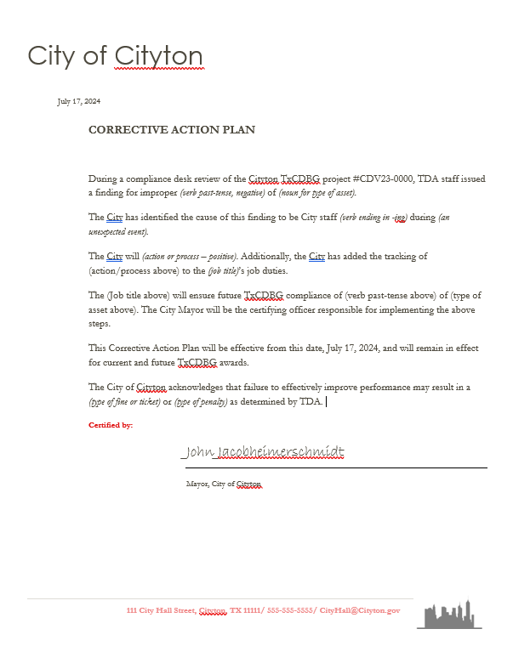
Role of Compliance Monitor
Notes:
In order to resolve a Finding or Performance Deficiency, TDA may require the Grant Recipient to develop a written corrective action plan (CAP). But before we break down the requirements of an acceptable corrective action plan, let’s plug in our mad lib prompts we came up with earlier to see how well we did in addressing the issues identified from our compliance review.
(read Mad Lib)

Slide 13
Corrective Action Plan (CAP)
Acknowledgment
Identify the cause
Identify parties to the CAP
Identify the certifying official
Date of implementation
Acknowledge outcome of future sanctions
Notes:
Of course, a real CAP is going to take a bit more effort than a mad lib. There should be substance and specifics that are tailored to the locality’s actual needs to address the issues identified.
The CAP is subject to TDA’s review prior to acceptance and must specifically address the known cause(s) of the violation or performance issue and provide a substitutive (manageable) plan for improving future performance.
CAPs must be on the Grant Recipient’s letterhead, signed by the certifying officer, and, at minimum, must include the following 6 parts.
A statement acknowledging the violation determined in TDA’s monitoring finding.
Identify the cause of the violation and specify the process to be implemented for improving performance and complying with program requirements.
Identify who will be involved in the process.
Name a certifying officer responsible for implementing the plan.
Provide the date on which the plan of action will be implemented, which includes a statement affirming that the CAP will remain in effect for any future TxCDBG awards.
A statement acknowledging that failure to effectively improve performance may result in a reduction of funding or other sanctions as determined by TDA.

Slide 14
Non-compliance Procedures
Response due within date specified
Failure to resolve non-compliance:
Funds on hold
Disallowance of costs/deobligated
Reduction of administrative fees
Other settlement:
Scoring penalty
Prohibition from applying
Notes:
1) Grant Recipient must provide a complete response in writing within 30 days. If more time is need, the grant recipient must request additional time- please do not ignore the letter
2.) Failure to resolve non-compliance findings and/or concerns may result in:
• remaining balance of the TxCDBG funds is placed on hold, or de-obligated;
• Unresolved findings may result in repayment of funds;
• or cause a reduction in the reimbursement of administrative fees in accordance with program policy.
o Acquisition 10%
o Environmental Clearance 15%
o Equal Employment Opportunity/Fair Housing 10%
o Labor Standards 15%
o Inaccurate or incomplete reporting 10%
penalized in the scoring process for future funding
Serious or unresolvable noncompliance may result in prohibition from applying for TDA grant funds for period of time

Slide 15
Non-Compliance Procedures
Violation Amount of Reduction
• Acquisition 10%
• Environmental clearance 15%
• Equal opportunity/fair housing 10%
• Labor standards 15%
• Financial management 10%
• Procurement 15%
• Inaccurate, incomplete, or delinquent reporting 10%
Progress Reports
Project Completion Report
Section 3 Report
Required written response failing to meet an established due date
Notes:
Failure to resolve non-compliance findings may result in the deobligation of any remaining grant funds or repayment of any disallowed costs.
Furthermore, violations regarding the on-screen categories may cause a reduction in the reimbursement of administrative fees in accordance with the table on this slide.
While the budget reductions are typically levied against the administrative budget line, the cause of the violation may not have been a result of the grant administrator’s actions or inactions. Therefore, it is up to the Grant Recipient and the applicable parties to resolve any dispute resulting from the budget reduction.
Note that if the CDBG budget does not include an administration category or cost, TDA may reduce funds from another budget line item.
Violations may cause the Grant Recipient to be:
penalized in scoring for future applications
precluded from applying for future funding for a specified period of time
or other sanctions that are deemed allowable by program rules, regulations, policies, agreement provisions, and law.

Slide 16
Post Monitoring Report
Required prior to closeout:
Supplemental financial records
Ensure project objectives have been fulfilled
Provide other related documents, if applicable
Notes:
New: Closeout approval is competed by program and NOT by program monitor. GR will not receive an Administratively Complete letter.
Prior to closeout approval, the assigned monitor must ensure that any additional documentation not previously reviewed for compliance is submitted for review. This may include additional documents such as:
supplemental financial records (grant, local & additional/cost overruns)- The AO has certified the project is complete, thus these records should be readily available
other related records such as labor or additional procurement that occurred after the monitoring review
ensure that Project activities have been fulfilled, including beneficiaries and cost eligibility
The program monitor will change the status to “Monitoring Follow-up Required” in order to allow the GR to upload the required documentation.
Closeout WILL NOT be approved until all records have been submitted and accepted.
Upload the financials records in the “Final Financial Review” section. Keep in mind the AO must again submit the document.
If the project was competed and the monitoring review has not been conducted, please contact your assigned monitor asap as the closeouts cannot be uploaded until the review is at least initiated by the monitor.

Slide 17
Administratively Complete
2 CFR 200.344 closeout of CDBG award does not affect:
TDA’s right to disallow costs and /or recover funds on the basis of a later audit or other review;
The Grant Recipient’s obligation to return funds as a result of subsequent refunds, corrections or other transactions;
Grant Recipient’s responsibilities for record retention;
TxCDBG property management and disposition requirements; and/or
Audit requirements
Notes:
Once all related expenditures have been submitted, any non-compliance findings are resolved and acceptable close-out reports are received, the agreement status will be changed to administratively complete.
However, its important to keep in mind that 2 CFR §200.344 specifies that the administrative closeout of a CDBG award does not affect single audit requirements or TDA’s right to disallow costs or recover funds identified at a later review.
If any discrepancies are found, the GR is obligated to return any ineligible costs and/or make payments to vendors not reimbursed properly and document the records.
In addition, 2 CFR 200.334 states that Grantees or subgrantees must retain all required records for three years after grantees or subgrantees make final payments and all other pending matters are closed.
RESOURCES such as sample monitoring checklist, list of support documentation and instructions are in chapter 13.

Slide 18
Questions/Comments

